Slide 1
MINI PROJECT
EMPLOYEE PAYROLL AND PAYSLIP GENERATION IN C
By REALSOFT PROGRAMMING
MEMBERS:
SAFFIUDDIN
SANTHANAKUMAR
SHAHUL HAMEED
NEHAL AHMED
ARSHAD

Slide 2
INTRODUCTION
Our team, REALSOFT PROGRAMMING has developed a C program to generate a payslip for employees in a organization
This program was coded using basic concepts like the use of looping and control statements
When executed, this program accepts the input values like name, emp ID, basic salary from the user while the user interacts with the primitive options system to control the flow of program execution

Slide 3
Modules used
STANDARD INPUT()
CALC ()
OPTIONS ()
DISPLAY ()
PAYSLIP_DISPLAY ()
PAYSLIP_GEN ()
CREDITS ()

Slide 4
MODULE EXPLANATION 1
STANDARD INPUT()
Used receive the input from the user
CALC()
Used to calculate values for HRA,DA,MA from basic salary
Also finds the gross and net salary as well as total amount deducted

Slide 5
2
OPTIONS ()
Used to display certain options for the user to choose from depending on their choice
DISPLAY()
Displays the employee’s payroll in list format
PAYSLIP_GEN()
Used to generate the payslip

Slide 6
3
PAYSLIP_DISPLAY()
Used to display the payslip for the requested employee
CREDITS
It displays the names of the members of REALSOFT PROGRAMMING who contributed in developing this program

Slide 7
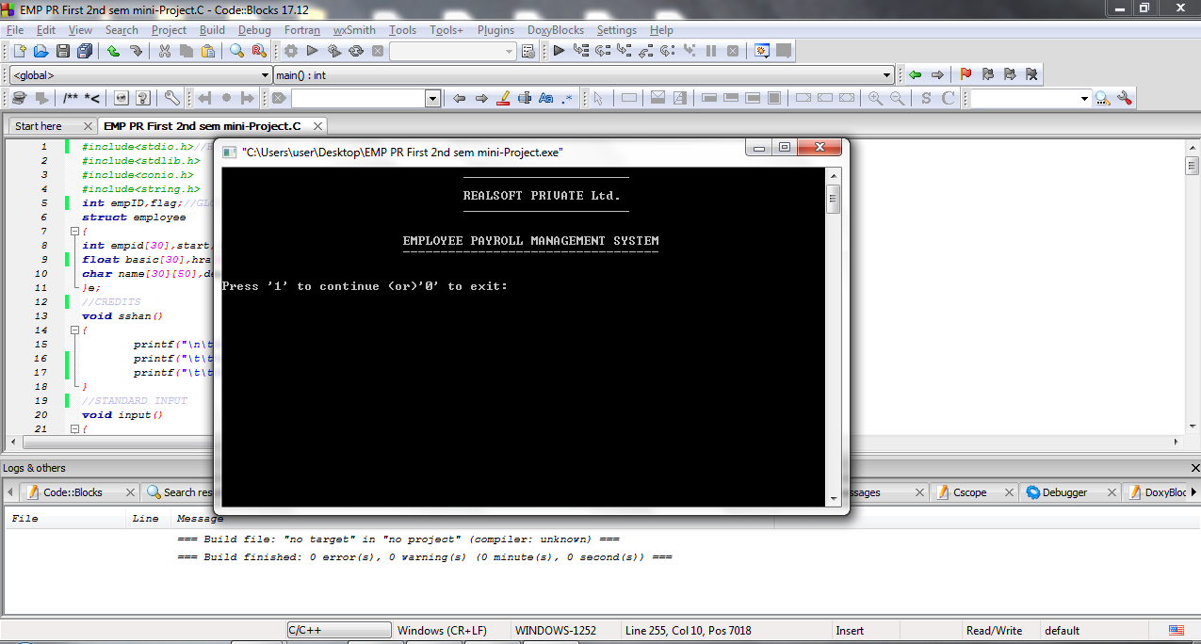
OUTPUT SCREENSHOTS

Slide 8
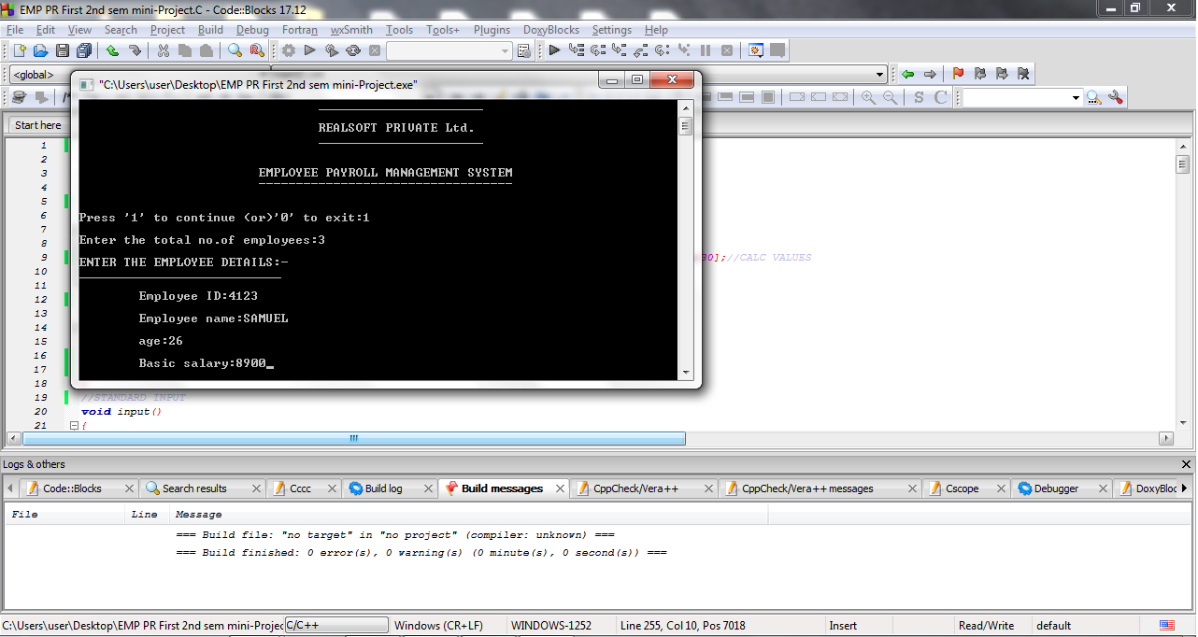

Slide 9
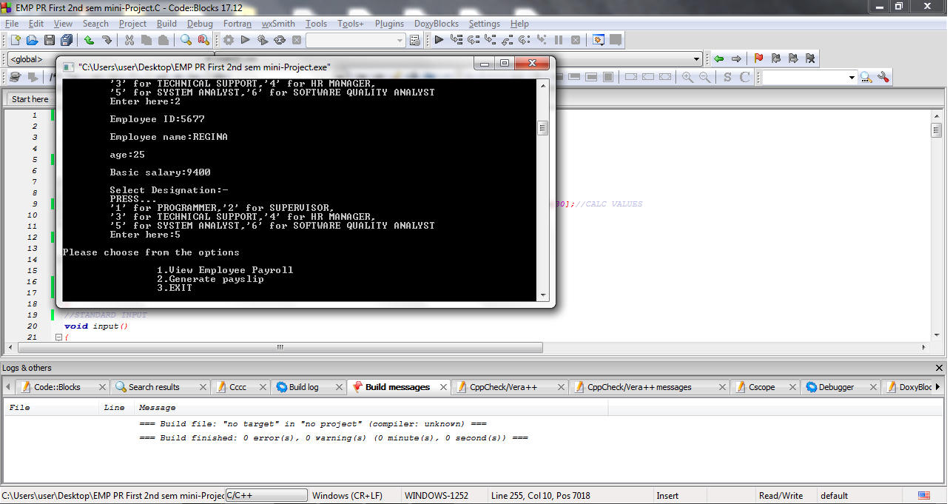

Slide 10
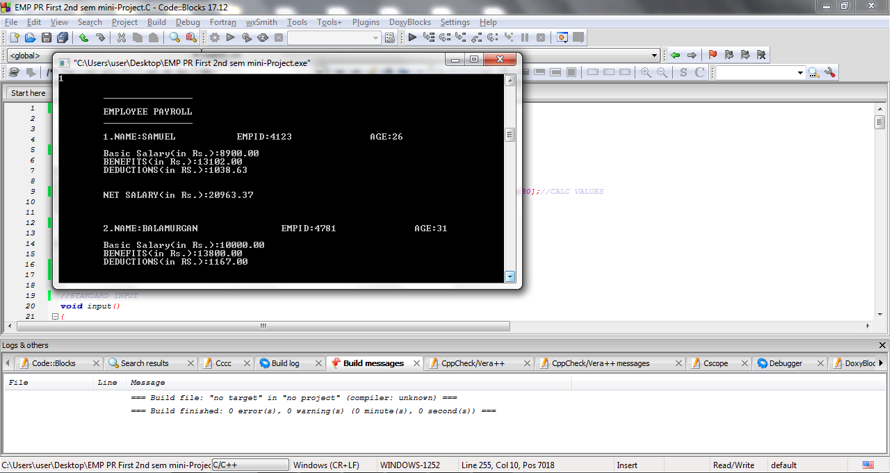

Slide 11
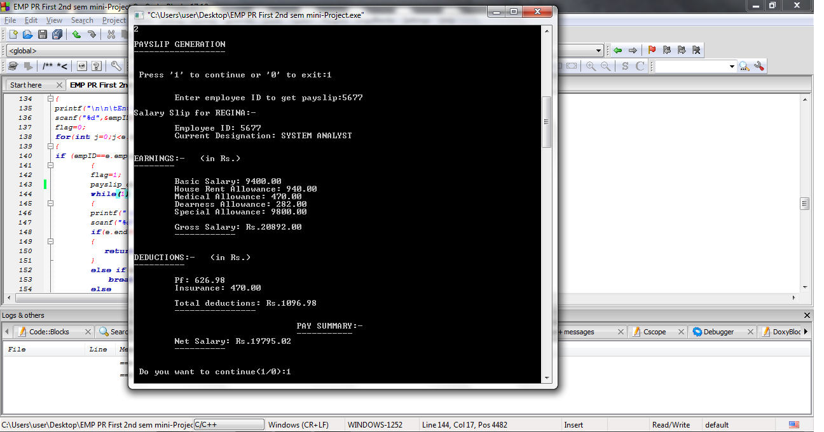

Slide 12
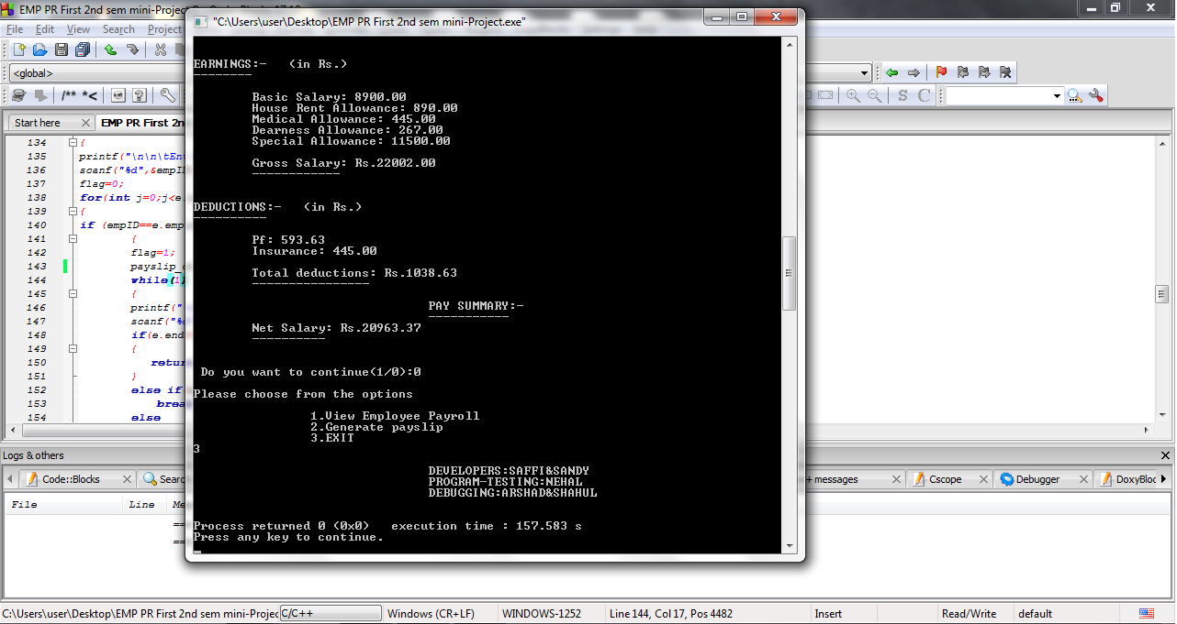

Slide 13

THANK YOU

